Slide 1
SER 334 A Session
SI Session
Monday, February 5th 2024
7:00 pm - 8:00 pm MST

Slide 2
{
Agenda
Sample Problems!
Module 7
Module 8
Sample Requests

Slide 3
SI Session Expectations
Thanks for coming to the SER 334 SI session. We have a packed agenda and we are going to try to get through as many of our planned example problems as possible. This session will be recorded and shared with others.
If after this you want to see additional examples, please visit the drop-in tutoring center.
We will post the link in the chat now and at the end of the session.
tutoring.asu.edu
Please keep in mind we are recording this session and it will be made available for you to review 24-48 hours after this session concludes.
Finally, please be respectful to each other during the session.

Slide 4

Interact with us:
Zoom Features
Zoom Chat
Use the chat feature to interact with the presenter and respond to presenter’s questions.
Annotations are encouraged

Slide 5
SER 334
Threading Issues
Test and Debugging
Data Splitting
Identifying Tasks
Data Dependency
Balance
Identifying independent functionality
Ensuring comparable amounts of work
Partitioning and minimizing memory use
Some tasks must be performed sequentially
Multiple “executors” for each line makes it harder to identify the culprit

Slide 6
SER 334
Threading Issues
E
Identifying independent functionality
Ensuring comparable amounts of work
Partitioning and minimizing memory use
Some tasks must be performed sequentially
Multiple “executors” for each line makes it harder to identify the culprit
Test and Debugging
Data Splitting
Identifying Tasks
Data Dependency
Balance
C
A
D
B

Slide 7
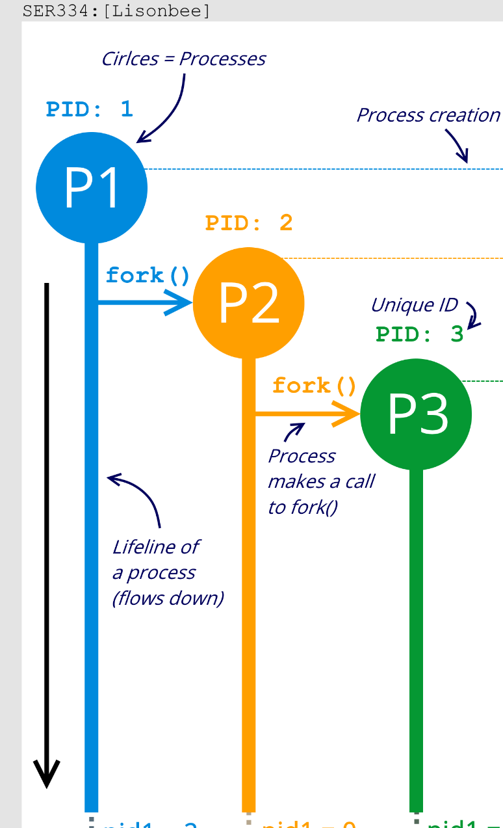
(a) Using “lifeline notation” (sequence diagrams with threads), draw the creation of processes and threads during execution.
(b) How many unique processes are created? (Do not include the initial process.)
(c) How many unique threads are created? (Hint: processes don't count!)
SER 334
Execution Tracing
1
Thread
Process
2
Fork
3

Slide 8
(a) Using “lifeline notation” (sequence diagrams with threads), draw the creation of processes and threads during execution.
(b) How many unique processes are created? (Do not include the initial process.)
(c) How many unique threads are created? (Hint: processes don't count!)
SER 334
Execution Tracing
pid_t pid;
pid = fork();
thread_create(...);
if (pid == 0) {
pid = fork();
if(pid == 0)
pid = fork();
}
thread_create(...);

Slide 9
(a) Using “lifeline notation” (sequence diagrams with threads), draw the creation of processes and threads during execution.
(b) How many unique processes are created? (Do not include the initial process.)
(c) How many unique threads are created? (Hint: processes don't count!)
SER 334
Execution Tracing
pid_t pid;
thread_create(...);
pid = fork();
thread_create(...);
if (pid == 0) {
pid = fork();
if(pid == 0)
pid = fork();
}
thread_create(...);

Slide 10
Module 7 Sample
SER 334
5. [Acuña] Consider the code for Peterson's Solution. Notice that part of the algorithm has been commented out. Explain how this changes it's functionality. Will it still solve the critical section problem? Explain.
Samples
//shared memory
int turn = 0;
bool flag[2] = { false, false };
//for some process i
do {
flag[i] = true;
turn = j;
while (flag[j] /* && turn == j */);
//critical section
flag[i] = false;
//remainder section
} while (true);

Slide 11
Module 7 Sample
SER 334
9. [Lisonbee] Given the following partially implemented code, implement the calls to mutex lock and unlock in the appropriate spots in the runner function to ensure that two threads don't write to the same index in the memory array.
Samples
int main() {
pthread_t threads[NUM_THREADS];
pthread_mutex_init(&lock, NULL);
for (int i = 0; i < NUM_THREADS; i++) {
pthread_create(threads[i], NULL, runner, (i * 7));
}
for (int i = 0; i < NUM_THREADS; i++) {
pthread_join(threads[i], NULL);
}
pthread_mutex_destroy(&lock);
return 0;
}
void* runner(void* arg) {
memory[counter] = *((int*)arg);
printf("Wrote %d at index %d\n", *((int*)arg), counter);
counter++;
pthread_exit(0);
}

Slide 12
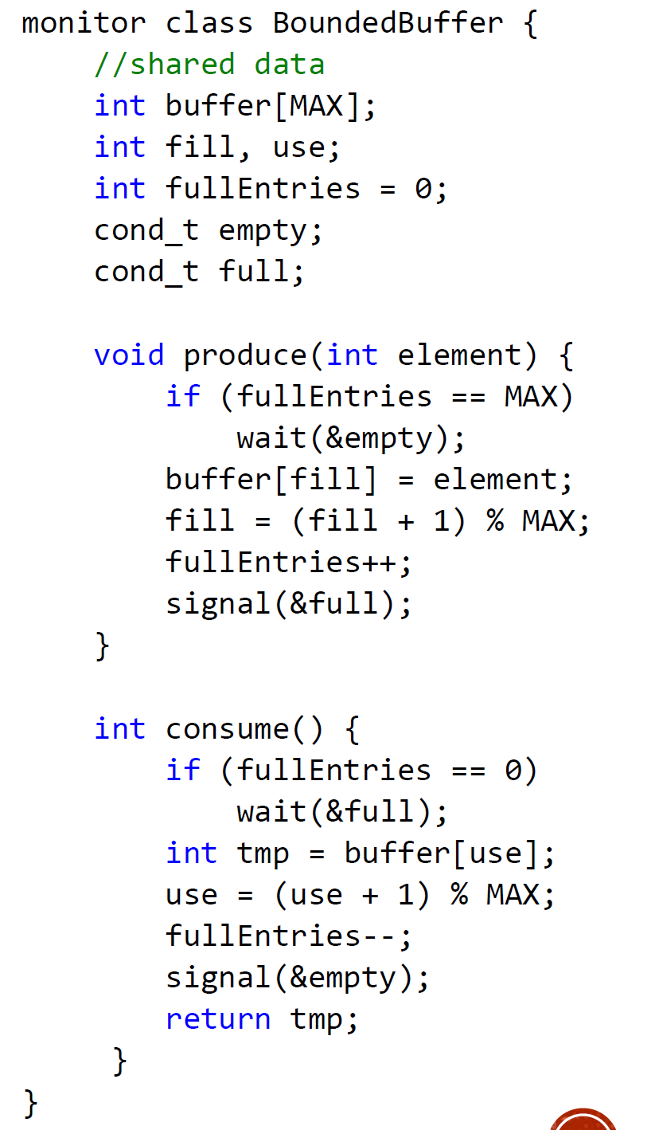
Producer/Consumer Visual
SER 334
Producer/Consumer

Slide 13

Producer/Consumer Visual
SER 334
P
Producer/Consumer
C

Slide 14
Producer/Consumer Visual
SER 334
P
Producer/Consumer
C

Slide 15
Module 8 Sample
SER 334
4. [Acuña] Consider the following solution to the producer consumer problem from Silberschatz.
This solution to the producer consumer problem with a bounded buffer requires three semaphores - can the problem be solved with less? Explain.
Samples
//shared data. [Operating Systems Concepts by Silberschatz.]
int n;
//also a buffer data structure
semaphore buf_mutex = 1;
semaphore empty = n;
semaphore full = 0;
//producer
do {
// produce next_produced
wait(empty);
wait(buf_mutex);
// add next_produced to the buffer
signal(buf_mutex);
signal(full);
} while (true);
//consumer
do {
wait(full);
wait(buf_mutex);
// move from buffer to next_consumed
signal(buf_mutex);
signal(empty);
// consume next_consumed
}while (true);

Slide 16
Module 8 Sample
6. [Lisonbee] The bounded buffer problem is a result of producing and consuming work asynchronously at different and/or variable rates. Provided below is are the producer and consumer functions used by a program.
Assume that the producer and consumer are running in parallel. In order to solve the bounded buffer problem demonstrated here, the appropriate calls to wait and signal need to be added. Rewrite the above code using wait and signal and initialize the 3 semaphores to the appropriate values (Note: you must use all three semaphores at least once in your calls to wait and signal).
SER 334
Samples
int data[15], i0 = 0, i1 = 0;
semaphore mutex = ... ;
semaphore empty = ... ;
semaphore full = ... ;
void producer() {
while (1) {
data[i0] = i0 * i0;
i0 = ++i0 % 15;
}
}
void consumer() {
while (1) {
printf("%d\n", data[i1]);
i1 = ++i1 % 15;
}
}

Slide 17
SER 334
Concept Check
When should you use process synchronization?
Always
For shared resources
With Threads
Never

Slide 18
SER 334
Concept Check
When using a lock (of any type), where should you place the lock and unlock calls?
Around the critical section
Before creating a thread
Within the runner
Before the fork

Slide 19
SER 334
Concept Check
Which of the following are most likely to be an atomic action?
int w = 5;
int x = 3 + 9;
int y = w + 7;
int z = x + y;

Slide 20
SER 334
Scratch Space

Slide 21
Upcoming Events
SI Sessions:
Sunday, February 11th at 7:00 pm MST Cancelled - Good luck on Exam 2!
Monday, February 12th at 7:00 pm MST
Review Sessions:
Exam 2 Review: Thursday, February 8th 7:00 pm - 9:00 pm MST
Exam 3 Review: TBD

Slide 22

Questions?
Survey:
http://bit.ly/ASN2324

Slide 23


More Questions?
Check out our other resources!
tutoring.asu.edu
1-
2-
Click on ‘Go to Zoom’ to log onto our Online Tutoring Center.
Click on ‘View the tutoring schedule’ to see when tutors are available for specific courses.

Slide 24
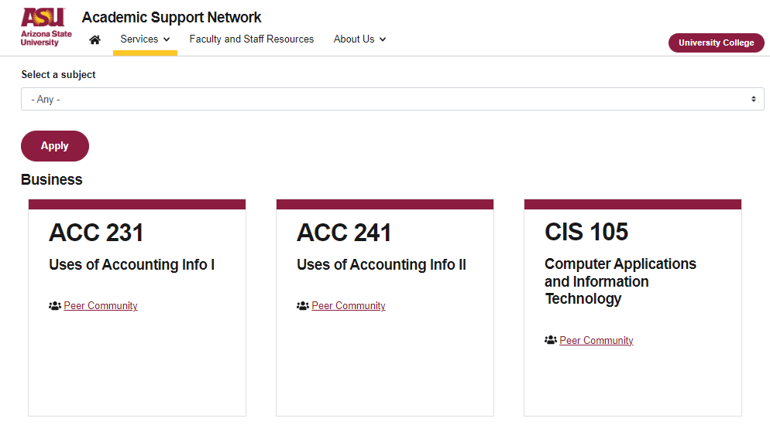

More Questions?
Check out our other resources!
tutoring.asu.edu/online-study-hub
Don’t forget to check out the Online Study Hub for additional resources!

Slide 25
Additional Resources
Course Repo
Course Discord
BMP File Format (Wiki)
Linux Kernel API
Bootlin - Linux Cross Referencer
Dining Philosophers Interactive
Producer/Consumer Visual

